Slide 1






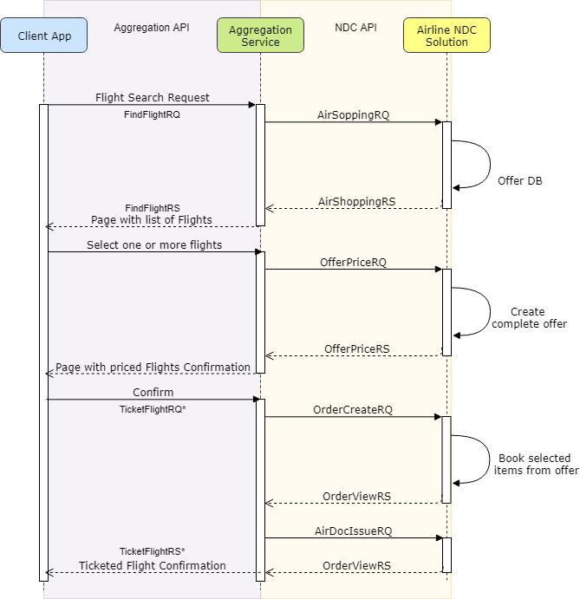
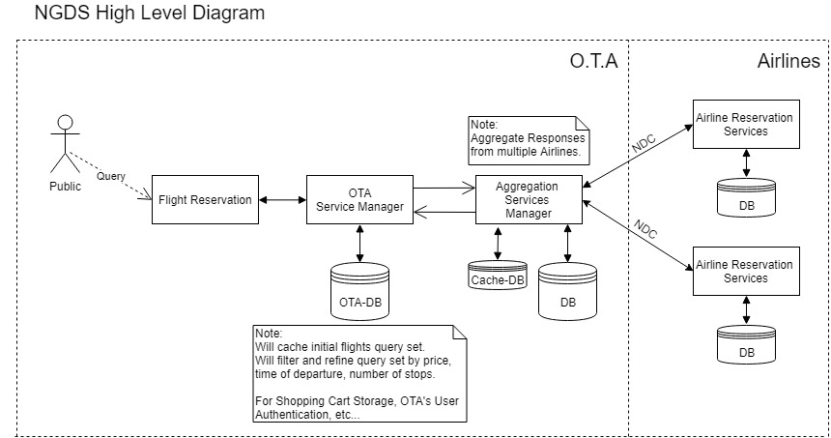
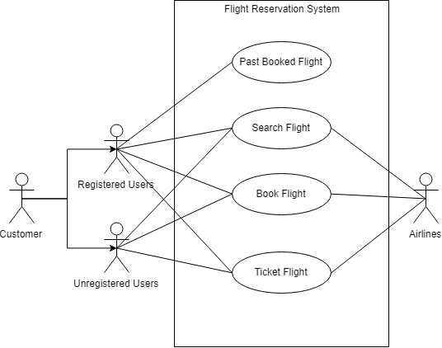
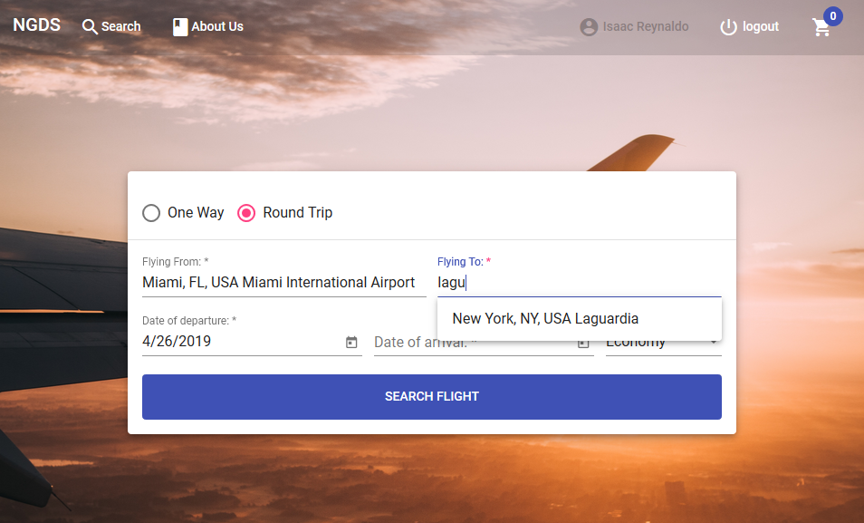
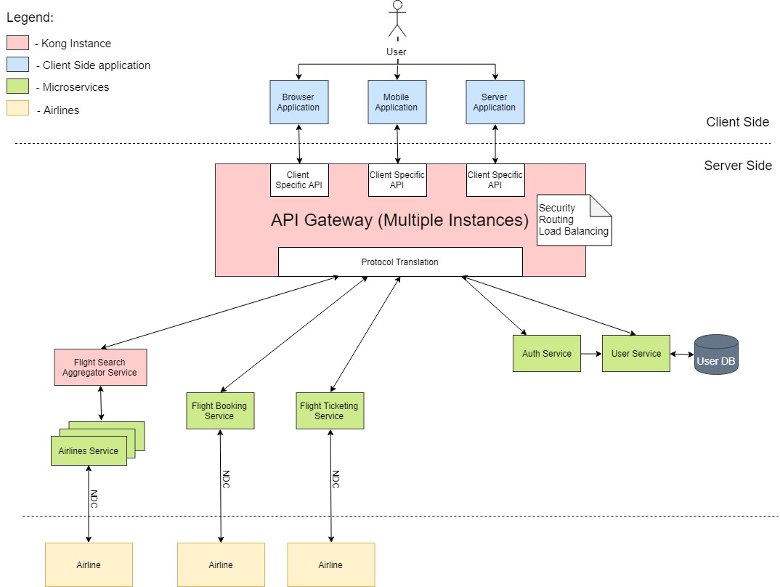
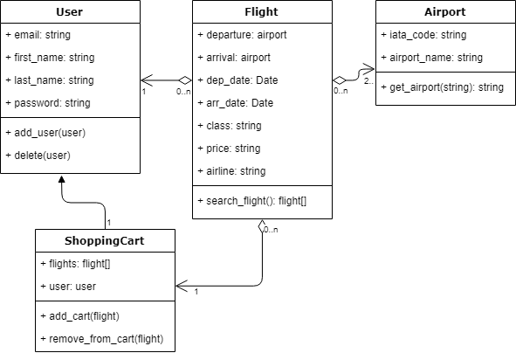
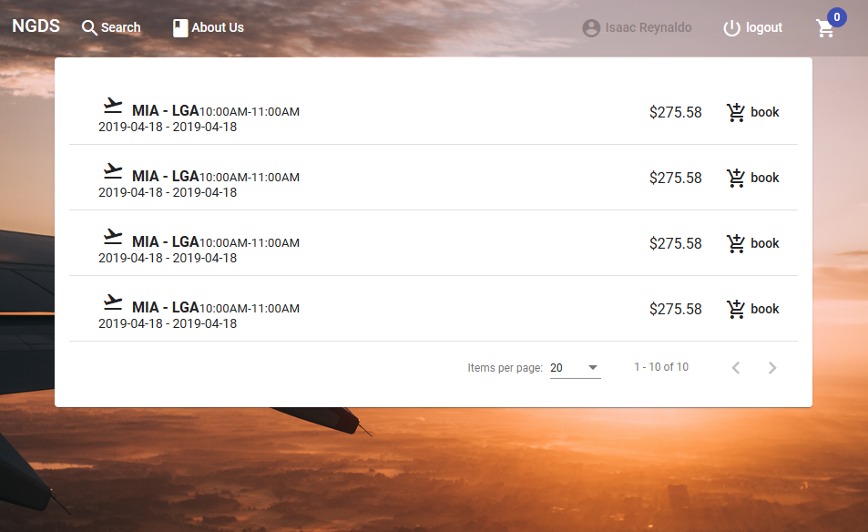
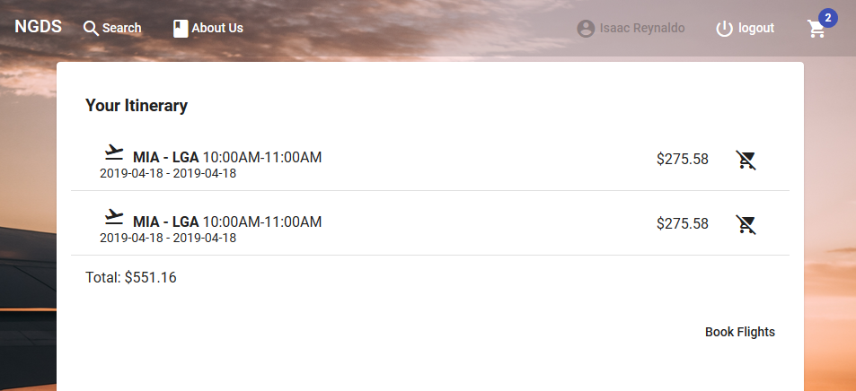

Next Generation Airline Data
Exchange Simulator 1.0
Senior Project, Spring 2019
express
Student: Isaac Reynaldo, Florida International University.
Mentors: Steve Luis, Dr. Miguel Alonso.
Instructor: Dr. Masoud Sadjadi. Florida International University.
Abstract
UML Diagrams
Requirements
In a fast-growing Travel Industry, the NDC program was launched by IATA for providing the market with a new adoption of an XML-based data transmission standard called the NDC standard. This standard has been instrumental for enhancing the communication between Airlines and Travel Agents due to its open nature and widespread Airline support. The Next Generation Airline Data Exchange Project was launched by Florida International University to investigate and implement an efficient, open source NDC centric architecture. As the project was being developed it evolved from a monolithic architecture to a microservices one, separating each NDC transaction to individual microservices with one purpose, thus reducing coupling and increasing cohesion.
Sequence Diagram
User can search a one way flight.
User can search a round trip flight
User can create an account.
User can add flights to their Shopping Cart.
User can search for aggregated offers from different airline, to find best deal.
User will find the wanted flights quickly.
Caching Solution
Built a Caching Solution by using TTL from NDC offers.
Caching was built on the aggregation level.
Caching was built using Mongoose so it’s scalable and updated every one minute.
Caching Reduces the amount of Requests sent to the Airlines, thus making the application faster.
For cashing at an User Level Local Storage can be used in a future iteration of the project to reduce even further the requests made.
System Design (First Iteration)
Summary
Throughout this project we were able to demonstrate that an aggregation based service embedded to the Online Travel Agent it’s an efficient mechanism for supporting NDC transactions between Airlines and OTA’s. Bellow are the features that were implemented and the ones that should be implemented in the future.
Implemented:
One Way Flight Search.
Round Trip Flight Search.
Account Creation.
Shopping Cart.
Future Implementation:
Booking Flights.
Ticketing Flights.
Payment.
The Sequence Diagram above shows the sequential steps necessary for ticketing a flight within our system.
The three most important steps in an NDC centric system for ticketing a flight are Search Flight, Book Flight, and Ticket Flight.
- The first Iteration of the system was a monolithic Architecture.
The Architecture was divided in two very important pieces:
The OTA (Online Travel Agent):
The Flight Reservation Service was focused on User Interactivity, and the Aggregation Service would add all the transactions coming from the airlines and cache them as long as the Airlines Permitted them.
The Airlines:
Airlines Reservation Services focuses in the specific Airline which provides with the flights for booking and ticketing. The Airline had its own Data Base and it could be duplicated as many times as possible to do stress Testing on the OTA’s.
Use Case Diagram
Screenshots
Search Flight
Future Design (Second Iteration)
Class Diagram
Application can be broken down into different services for the different NDC transactions:
Flight Search
Flight Booking
Flight Ticketing
Every service can be written independently with different programming languages and architecture.
The main component in the microservice architecture is called the API Gateway and it’s purpose is to provide with:
Load Balancing.
Security.
Routing.
Monitoring and Analytics
Implementation
Booking Flight
To implement the Online Travel Agent Service, we used the MEAN Stack. Angular 7 was used for the Browser client and it connects to the back-end API which it was written with in Express framework. MongoDB is used for caching the Flight Responses that are coming from the aggregated Airlines.
Acknowledgments
I would like to thank my mentors for this project, Steve Luis and Dr Miguel Alonso, as well as Maria Reyes for helping us throughout everything.
Thank you professor Masoud Sadjadi for his support and I would also like to thank Farelogix Inc. for helping us with any Industry related questions we had.

